Slide 1
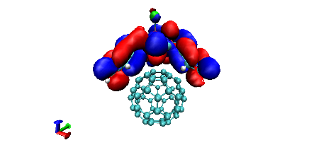
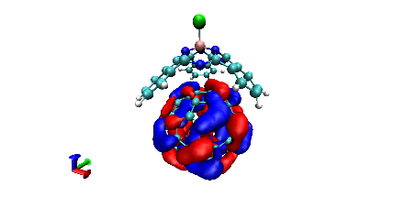
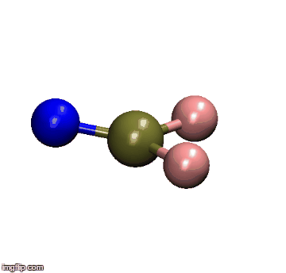
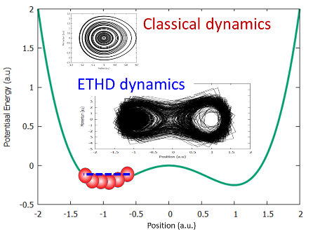
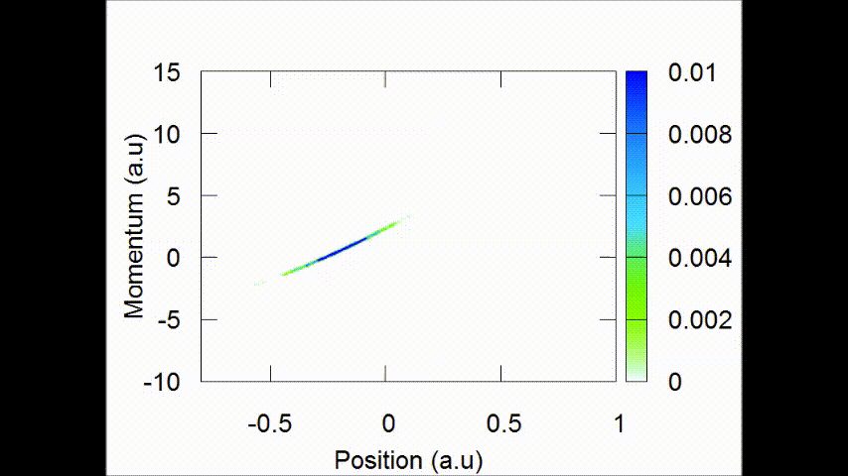

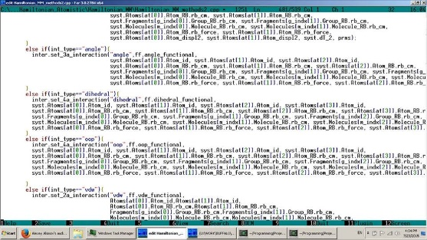

Research in the Akimov group:
Quantum Dynamics in Materials
Studies of solar
energy materials
Quantum dots
2D materials/ PV
Perovskites
Organic crystals and biomolecules
Theory of quantum dynamics
Novel quantum-classical methods
Non-adiabatic molecular dynamics
Theory of charge transfer
Methodology development and implementation
Electron and energy transfer
Photoinduced molecular dynamics
Methods for large-scale systems
Software development

Slide 2
Computational Materials Theory and Methods
Lecture 1:
Classical Molecular Dynamics
Alexey V. Akimov
University at Buffalo, SUNY

Slide 3
Outline
Modeling relies on statistical thermodynamics. Gibbs ensembles.
Ensemble averages.
Connection of statistical thermodynamics and MD. Ergodic hypothesis.
Time and ensemble averages.
Hamiltonian dynamics. EOMs and Integration schemes.
Non-Hamiltonian dynamics. NVT ensemble
Observables computed from MD simulations.
MD modeling protocols
Overview of available software for MD simulations.
Demonstrations with Libra. Homework #1

Slide 4
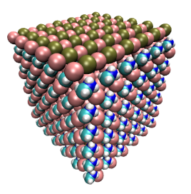
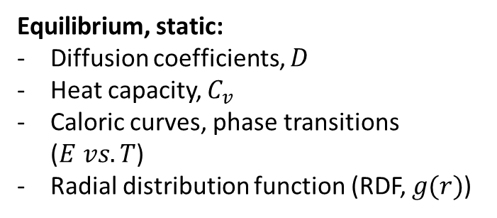
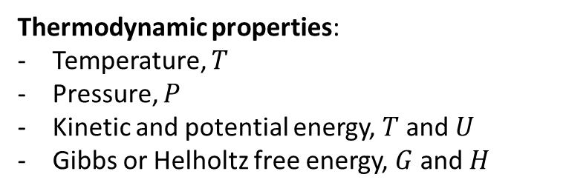
Modeling material systems
Atomistic model
Properties
Equilibrium, static:
Diffusion coefficients, $D$
Heat capacity, $C_{v}$
Caloric curves, phase transitions ($E vs. T$)
Radial distribution function (RDF, $g(r)$)
Thermodynamic properties:
Temperature, $T$
Pressure, $P$
Kinetic and potential energy, $T$ and $U$
Gibbs or Helholtz free energy, $G$ and $H$
Structural characterization:
Most stable structure
Dynamical properties:
Kinetics of phase transitions
Mechanisms of reactions
Vibrational spectra, etc.

Slide 5
Modeling realistic systems
Ideal system
“Real” system
Real: all atoms interact with each other
Include all the non-idealities:
Defects (vacancies, interstitials,
dislocations, kinks, dangling bonds, etc.)
Adsorbates (adatoms, surface dangling
bonds passivation, etc.)
Solvation and counterions
Phases and grain boundaries

Slide 6
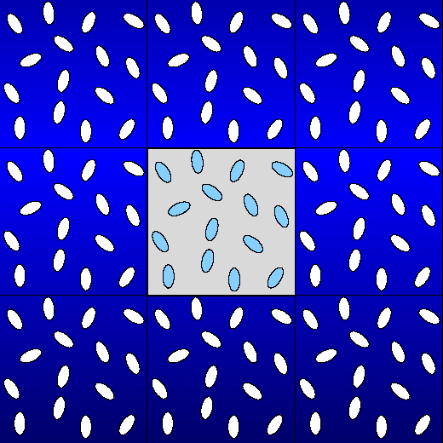
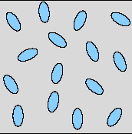
Periodic boundary conditions (PBC)
Real systems = are of $N_{A}$ size, we can model $1−{10}^{6}$ atoms, usually around $1000$
To mitigate these effects:
Use PBC
Surface/volume ratio is large
The structure of the surface is different from the bulk
PBC
Surface deffects!

Slide 7
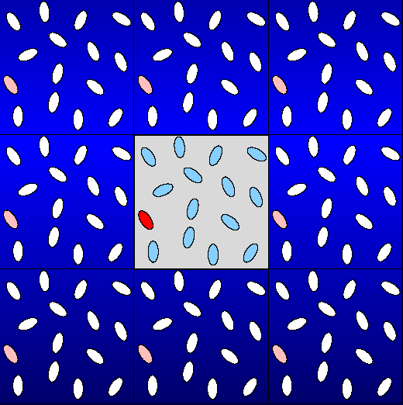
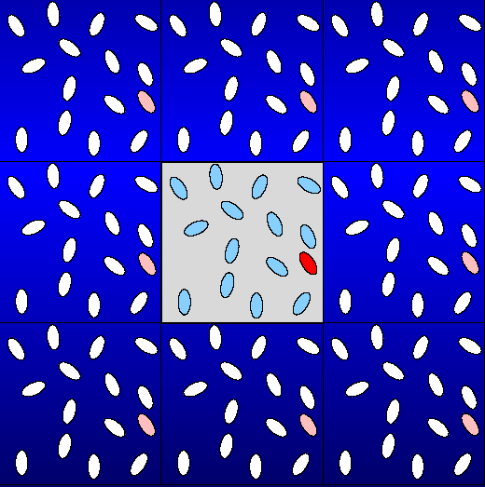
How PBC works
Molecules that exit from the left wall re-enter simulation cell from the right wall
simulation cell
replica
(periodic image)

Slide 8
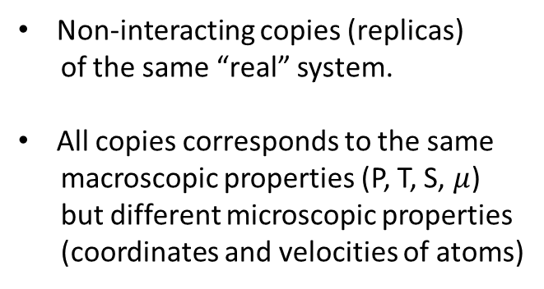
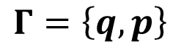
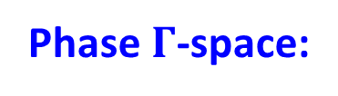
Gibbs Ensemble and phase spaces
Gibbs Ensemble
Non-interacting copies (replicas)
of the same “real” system.
All copies corresponds to the same
macroscopic properties (P, T, S, $μ$)
but different microscopic properties
(coordinates and velocities of atoms)
{p}
Phase $Γ$-space:
$$Γ=\left\{q, p\right\}$$
{q}
coordinates of a
1 mole of particles
momenta of a
1 mole of particles
Each point is: {3*6*10²³; 3*6*10²³}

Slide 9
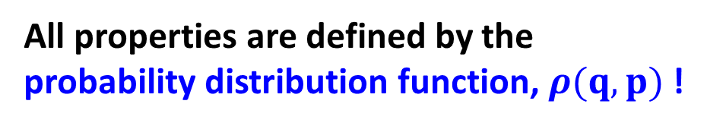
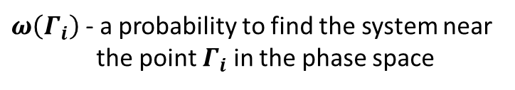
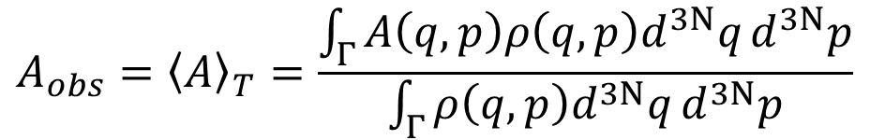
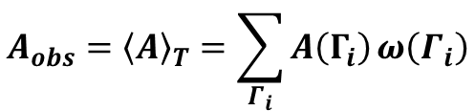
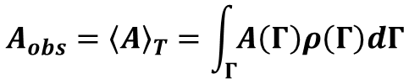
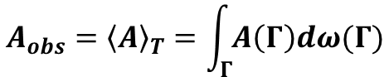
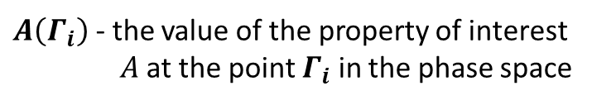
Observed properties are statistical quantities
To compute properties, we compute thermal (ensemble) averages
$ω\left(Γ_{i}\right)$ - a probability to find the system near
the point $Γ_{i}$ in the phase space
$$A_{obs}={\left\langle A\right\rangle }_{T}=\sum_{Γ_{i}}{A\left(Γ_{i}\right)}ω\left(Γ_{i}\right)$$
$A\left(Γ_{i}\right)$ - the value of the property of interest
$A$ at the point $Γ_{i}$ in the phase space
$$A_{obs}={\left\langle A\right\rangle }_{T}=\int_{Γ}{A\left(Γ\right)dω(Γ)}$$
$$A_{obs}={\left\langle A\right\rangle }_{T}=\int_{Γ}{A\left(Γ\right)ρ\left(Γ\right)dΓ}$$
$$A_{obs}={\left\langle A\right\rangle }_{T}=\frac{\int_{Γ}{A\left(q,p\right)ρ\left(q,p\right)d^{3N}q}d^{3N}p}{\int_{Γ}{ρ\left(q,p\right)d^{3N}q}d^{3N}p}$$
Ensemble average:
All properties are defined by the
probability distribution function, $ρ(q,p)$ !

Slide 10
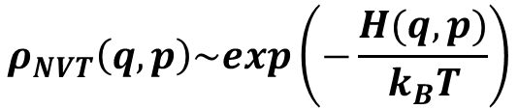
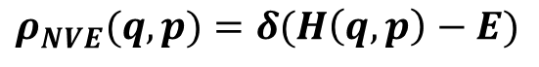
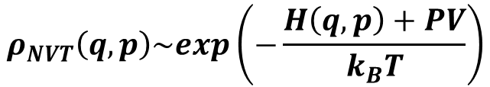
Classification of the Gibbs ensembles
NVE (microcanonical): Constant number of particles (N), volume (V), and total energy (E)
Nothing but the energy conservation requirement to the “regular” (Hamiltonian) dynamics
$$ρ_{NVE}(q,p)=δ(H\left(q,p\right)−E)$$
If your integrator or system preparation are bad (don’t conserve energy) –
you do not sample points from the correct NVE distribution function!
NVT (canonical): Constant number of particles (N), volume (V), and temperature (T)
$$ρ_{NVT}\left(q,p\right)\sim exp\left(−\frac{H(q,p)}{k_{B}T}\right)$$
“Thermostatted” MD:
Nose, Nose-Hoover, Andersen thermostats
NPT (isobaric-isothermal): Constant number of particles (N), pressure (P), and temperature (T)
$$ρ_{NVT}\left(q,p\right)\sim exp\left(−\frac{H\left(q,p\right)+PV}{k_{B}T}\right)$$
Closer to real experimental conditions
Critical to use in high-pressure studies

Slide 11
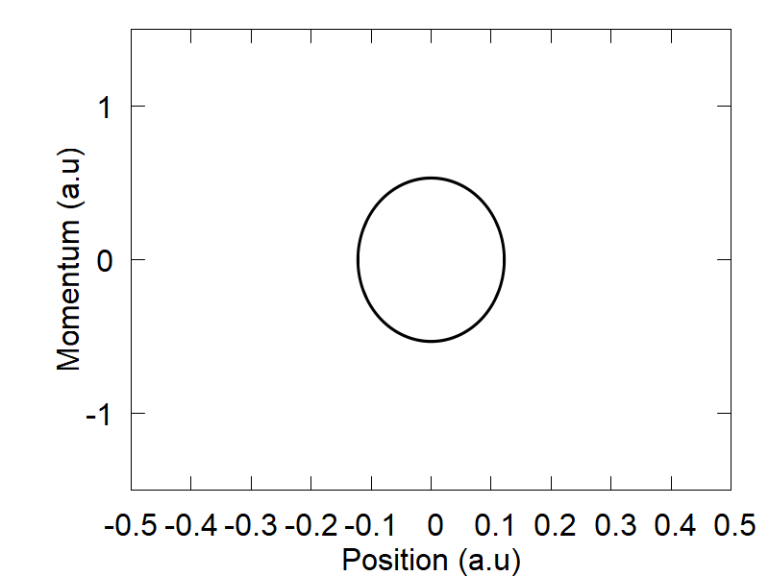
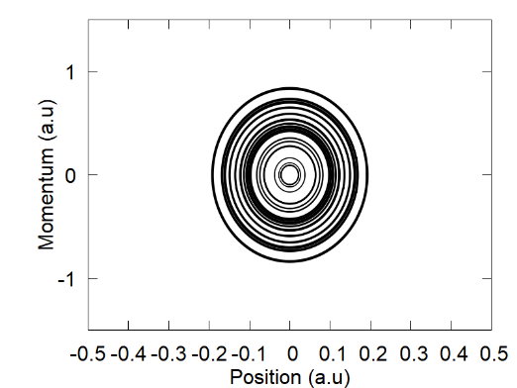
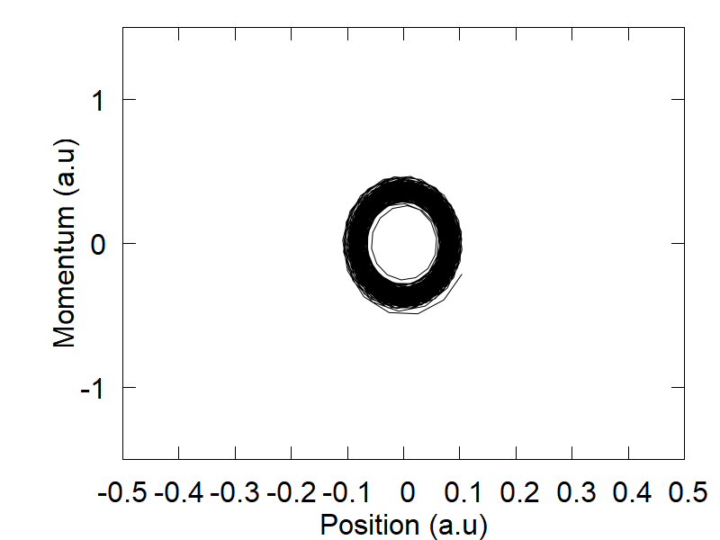
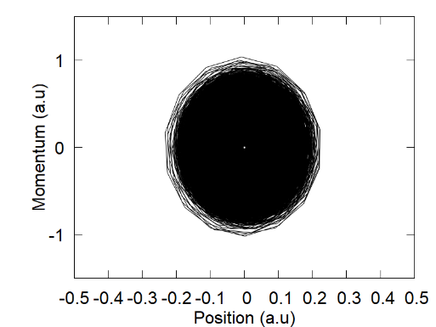
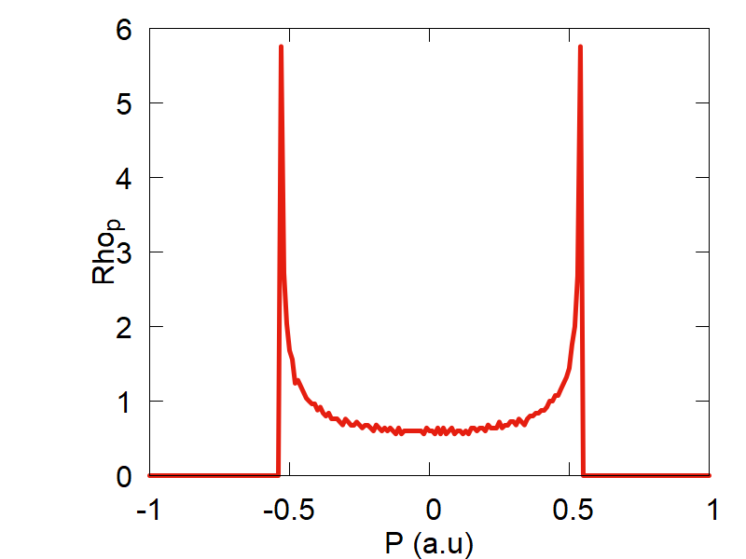
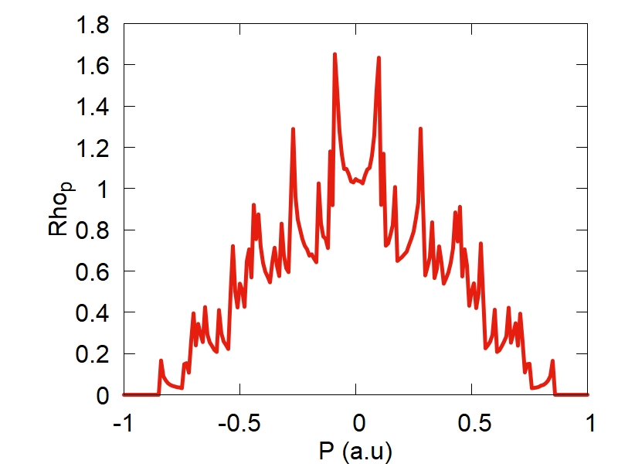
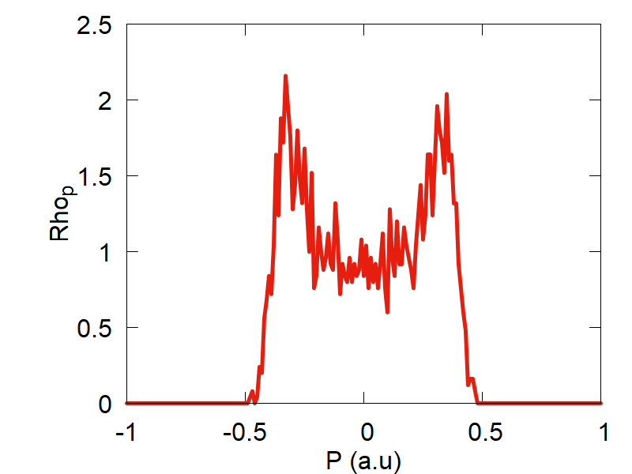
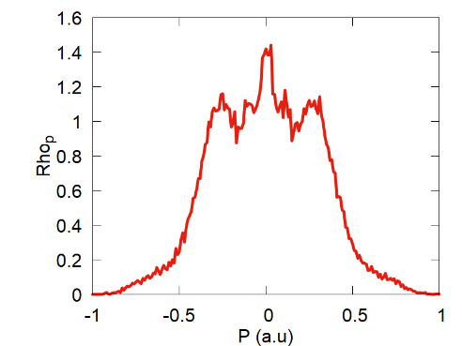
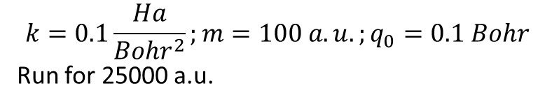
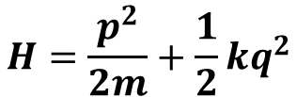
Examples of the Gibbs ensembles
$$H=\frac{p^{2}}{2m}+\frac{1}{2}kq^{2}$$
$$k=0.1\frac{Ha}{Bohr^{2}};m=100 a.u.;q_{0}=0.1 Bohr$$
Run for 25000 a.u.
NVE ensemble:
“NVT” ensemble:
Single trajectory
25 trajectories
Single trajectory
25 trajectories

Slide 12
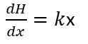
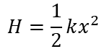
Practical exercises with Libra
Define your potential: in “Hamiltonian.py”
obj.ham_dia.set(0,0, 0.5*k*x*x*(1.0+0.0j) )
obj.d1ham_dia[i].set(0,0, k*x*(1.0+0.0j) )
$$H=\frac{1}{2}kx^{2}$$
$\frac{dH}{dx}=k$x
Define your system: in e.g. “nvt.py”
nnucl, ntraj = 1, 25
How many DOFs is per 1 trajectory. How many trajectories
mean_q.set(0,0, 0.1)
The center of the initial distribution. Must specify for each DOF
iM.set(0,0, 1.0/100.0)
The masses of each DOF
Define the simulation parameters : in e.g. “nvt.py”
params["k"]
Harmonic force constant
params[“dt"], params[“nsteps"]
Integration time step (a.u.) and the number of steps
Run the MD : in e.g. “nvt.py”
Q, P = run_nvt(nnucl, ntraj, q, p, iM, compute_model, params)
Run the analysis of MD trajectories : in e.g. “nvt.py”
compute_statistics(Q, idof, minx, maxx, dx, "_density_q.txt")

Slide 13
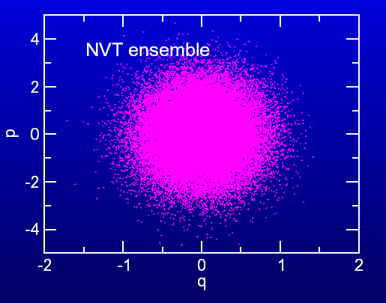
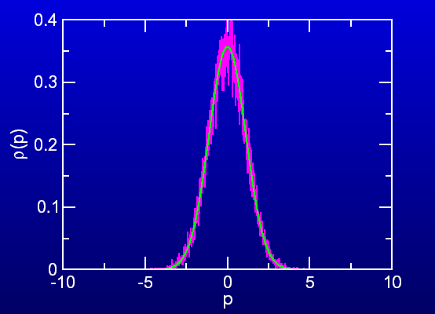
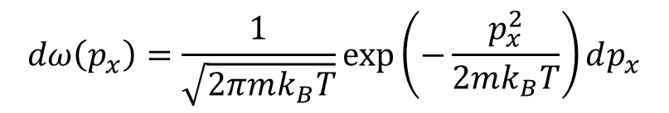
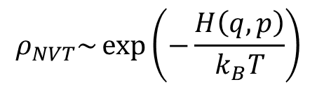
Examples of the Gibbs ensembles
Ideally, in the canonical ensemble we want:
$$ρ_{NVT}\sim \exp\left(−\frac{H\left(q,p\right)}{k_{B}T}\right)$$
$$dω\left(p_{x}\right)=\frac{1}{\sqrt{2πmk_{B}T}}\exp\left(−\frac{p_{x}^{2}}{2mk_{B}T}\right)dp_{x}$$
This may not happen in reality: Ergodicity
There are other methods of sampling (e.g. MC)

Slide 14
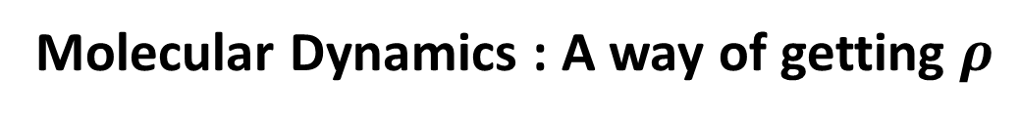
Molecular Dynamics : A way of getting $ρ$
This is where the statistical thermodynamics is connected to MD!!!
NVE ensemble
Evolution of a point in the phase Г-space (system) is given
by the integrating classical equations of motion (EOM).
The correct integration of the Hamiltonian EOMs ensures the
Total energy conservation.
Integration
Hamiltonian EOM
NVE ensemble
Hamiltonian dynamics

Slide 15
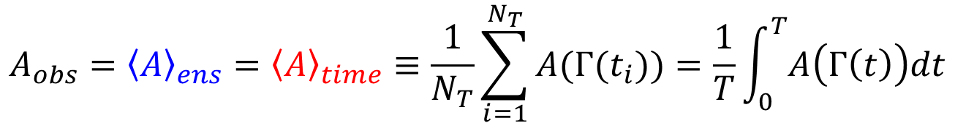
Connection between Stat. Mech. and MD
Ergodic hypothesis
Given an infinite time to evolve, the system
will visit all the points of the phase space
$$A_{obs}={\left\langle A\right\rangle }_{ens}={\left\langle A\right\rangle }_{time}≡\frac{1}{N_{T}}\sum_{i=1}^{N_{T}}{A(Γ(t_{i}))}=\frac{1}{T}\int_{0}^{T}{A\left(Γ\left(t\right)\right)dt}$$
The probability density is the distribution
of the “sampled” points in the phase space
(sampled using method for a given ensemble)

Slide 16

Dealing with the erogodicity
$$A_{obs}={\left\langle A\right\rangle }_{ens}={\left\langle A\right\rangle }_{time}≡\frac{1}{N_{T}}\sum_{i=1}^{N_{T}}{A(Γ(t_{i}))}=\frac{1}{T}\int_{0}^{T}{A\left(Γ\left(t\right)\right)dt}$$
Problem: How to make sure this is true?
Criteria:
Sufficiently long trajectories
Starting with many points
Choosing the right method

Slide 17
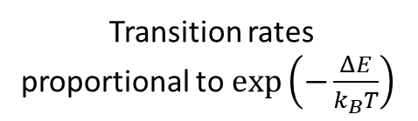
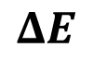
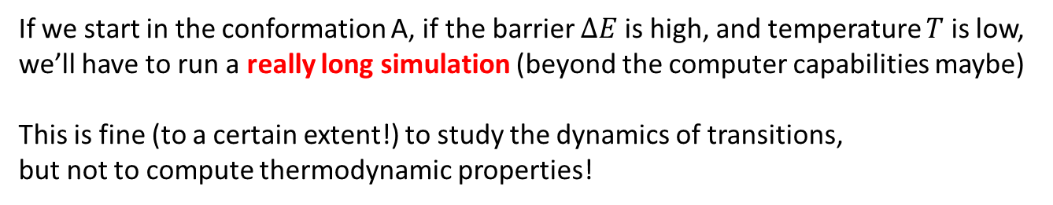
Criterion #1: Sufficiently long trajectories
A protein (as well as any material system)
may have two dominant conformations: A and B
A B
A B
kT
kT
Transition rates
proportional to $\exp\left(−\frac{ΔE}{k_{B}T}\right)$
$$ΔE$$
If we start in the conformation A, if the barrier $ΔE$ is high, and temperature $T$ is low,
we’ll have to run a really long simulation (beyond the computer capabilities maybe)
This is fine (to a certain extent!) to study the dynamics of transitions,
but not to compute thermodynamic properties!

Slide 18
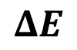
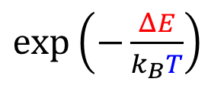
Criterion #1: Sufficiently long trajectories (cont.)
What can we do about it?
$\exp\left(−\frac{ΔE}{k_{B}T}\right)$
Increase temperature:
temperature accelerated dynamics (TAD)
Lower the effective barrier:
Hyperdynamics/metadynamics
kT
kT
$$ΔE$$
The computed rates must be “rescaled” to the original temperature/barrier
The dynamics is fictitious

Slide 19
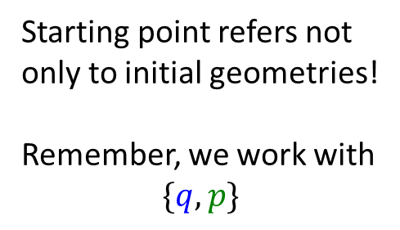
Criterion #2: Starting points
How about if we initialize one fraction of the trajectories to be in the
valley A, and the other fraction – to be in the valley B?
A B
Starting point refers not
only to initial geometries!
Remember, we work with
$$\{q,p\}$$
kT
kT
Initial geometries
(conformations)
Initial momenta
We don’t care about slow transitions
Need to know the relevant regions
in advance (e.g. chemical intuition)

Slide 20






Criteria #1 and #2: Long trajectories & Starting points
params["nsteps"] = 250
params["nsteps"] = 2500
params["nsteps"] = 25000
25 trajectories
1 trajectory
25 trajectories (1 DOF each) coupled to a Nose-Hoover thermostat (“NVT”) ensemble

Slide 21

Criterion #3: Choosing the right method
Not all systems and not all methods lead to ergodicity
Thermodynamic limit ($N→∞$):
NVE and NVT ensembles are equivalent
Smaller systems (e.g. Ndof = 1): they are
notably different
kT
In the NVE ensemble (Hamiltonian dynamics):
you will stay in this valley forever!
Energy conservation!
To explore other valleys, we need to
utilize NVT simulations!
(non-Hamiltonian dynamics)
The total energy of the system
is not conserved!

Slide 22








Criterion #3: Using the right method
Chain size = 1
Chain size = 5
Chain size = 25
Chain size = 250
This is not quite the right method: the NVT ensemble doesn’t make
sense for a system of 1 nuclear DOF

Slide 23




Basic terminology of classical mechanics
Material point: neglect size
What is large? Is the Earth large? Compared to what?
Choice of the coordinates:
Cartesian or Internal
Can be chosen as convenient
Equations of motion(EOM):
$$f\left(r,\dot{r},\ddot{r}\right)=0$$
This is what we solve by doing MD
Trajectory:
{p}
$$r\left(t\right)={\left(x_{1}\left(t\right),y_{1}\left(t\right),z_{1}\left(t\right),x_{2}\left(t\right),y_{2}\left(t\right),z_{2}\left(t\right),…\right)}^{T}$$
$$r\left(t\right)={\left(r_{1}\left(t\right),r_{2}\left(t\right),…, r_{N}(t)\right)}^{T}$$
$$r_{1}\left(t\right)={\left(x_{1}\left(t\right),y_{1}\left(t\right),z_{1}\left(t\right)\right)}^{T}=\left(\begin{matrix}x_{1}(t) \\ y_{1}(t) \\ z_{1}(t)\end{matrix}\right)$$
{q}

Slide 24




Degrees of freedom (DOF)
DOF = parameters that fully specify the geometry of a system
The number of DOFs: 3N – (# of constraints)
An atom: 3*1 = 3 DOFs
Diatomic molecule: 3*2 = 6 DOFs
DOFs: $x_{1},y_{1},z_{1},x_{2},y_{2},z_{2}$
(Cartesian)
DOFs: $x,y,z$
DOFs: $x_{1},y_{1},z_{1},r,φ,θ$ (polar)
DOFs:$X,Y,Z,r,φ,θ$ (internal)

Slide 25






Degrees of freedom (DOF)
Triatomic molecule: 3*3 = 9 DOFs
DOFs (internal):
DOFs: $x_{1},y_{1},z_{1},x_{2},y_{2},z_{2},x_{3},y_{3},z_{3}$
(Cartesian)
$X,Y,Z$ – position of the center of mass (COM)
$Θ,φ,ψ$ – angles the molecular inertia axes form with the external (Cartesian) coordinate system
$r_{12},r_{23}$ - interatomic distances
$Θ_{123}$ - an angle between two bonds

Slide 26





Hamiltonian Dynamics
$$H=K+U=\sum_{i=1}^{N}{\frac{p_{i}^{2}}{2m_{i}}}+U\left(\left\{q\right\}\right)=\sum_{i=1}^{N}{\frac{p_{x,i}^{2}+p_{y,i}^{2}+p_{z,i}^{2}}{2m_{i}}}+U\left(\left\{q_{1},q_{2},…q_{3N}\right\}\right)$$
Total energy
(Hamiltonian)
Kinetic energy
Potential energy
Hamiltonian EOM
(generate an NVE ensemble)
In a nutshell: Newton’s second law
$$\dot{q_{i}}=\frac{∂H}{∂p_{i}}$$
$$v_{i}=\dot{q_{i}}=\frac{p_{i}}{m_{i}}$$
$$\dot{p_{i}}=−\frac{∂H}{∂q_{i}}$$
$$\dot{p_{i}}=m_{i}a_{i}=−\frac{∂U}{∂q_{i}}≡F_{i}$$

Slide 27











Forces in MD
what this really means: we compute the x,y, and z components of
the forces acting on all particles $i$ just by taking derivatives of the
potential energy w.r.t. the corresponding coordinate
$$F=−\frac{∂U}{∂q}$$
More explicitly:
$$F_{1,x}=−\frac{∂U}{∂x_{1}}$$
$$F_{1,y}=−\frac{∂U}{∂y_{1}}$$
$$F_{1,z}=−\frac{∂U}{∂z_{1}}$$
$$F_{2,x}=−\frac{∂U}{∂x_{2}}$$
$$F_{2,y}=−\frac{∂U}{∂y_{2}}$$
$$F_{2,z}=−\frac{∂U}{∂z_{2}}$$
…
$$F_{N,x}=−\frac{∂U}{∂x_{N}}$$
$$F_{N,y}=−\frac{∂U}{∂y_{N}}$$
$$F_{N,z}=−\frac{∂U}{∂z_{N}}$$
Force and energy
evaluations – are the
most expensive
(time consuming)
parts of MD simulations
Where to get U?
Model Problems (here)
Force Fields (next)
Quantum Mechanics (later)

Slide 28



Forces in MD
Forces must be continuous! Or the MD won’t be stable (will produce meaningless data)
Energy
$$U=\left\{\begin{matrix}k\left(x+a\right), x∈[−a,0] \\ k\left(a−x\right),x∈[0,a]\end{matrix}\right.$$
$$F=\left\{\begin{matrix}−k, x∈[−a,0] \\ k,x∈[0,a]\end{matrix}\right.$$
Coordinate
This is gonna be a problematic potential!
-a 0 a
Don’t forget the sign! Otherwise the system will blow up
Defined in Hamiltonian.py
def compute_model(q, params, full_id):
Beware! Here we compute
just the derivative, not
the force, which is a negative
derivative!
$$H=\frac{1}{2}kx^{2}$$
obj.ham_dia.set(0,0, 0.5*k*x*x*(1.0+0.0j) )
$\frac{dH}{dx}=k$x
obj.d1ham_dia[i].set(0,0, k*x*(1.0+0.0j) )
Exercises:
Can you define your Python function for Morse potential?
Can you define your Harmonic potential for 2 particles connected by a spring in 1 D?

Slide 29




Solving (integrating) the Hamiltonian EOM
$$q_{i}\left(t+dt\right)≈q_{i}\left(t\right)+\frac{p_{i}\left(t\right)}{m_{i}}dt+\frac{f_{i}\left(t\right)}{2m_{i}}dt^{2}+O\left(dt^{3}\right)+O(dt^{4})$$
Taylor series
$$q_{i}\left(t−dt\right)≈q_{i}\left(t\right)−\frac{p_{i}\left(t\right)}{m_{i}}dt+\frac{f_{i}\left(t\right)}{2m_{i}}dt^{2}−O\left(dt^{3}\right)+O(dt^{4})$$
$$q_{i}\left(t+dt\right)≈2q_{i}\left(t\right)−q_{i}\left(t−dt\right)+\frac{f_{i}\left(t\right)}{m_{i}}dt^{2}+O(dt^{4})$$
Verlet algorithm
$$p_{i}\left(t\right)≈\frac{q_{i}\left(t+dt\right)−q_{i}\left(t−dt\right)}{2dt}+O\left(dt^{3}\right)$$
$$q_{i}\left(t+dt\right)≈q_{i}\left(t\right)+p_{i}\left(t\right)dt+\frac{dt^{2}}{2}f_{i}\left(t\right)$$
velocity Verlet algorithm
$$p_{i}\left(t+dt\right)≈p_{i}\left(t\right)+\frac{dt}{2}\left[f_{i}\left(t\right)+f_{i}(t+dt)\right]$$
More stable!

Slide 30




How to assess the quality of integration scheme?
In the isolated system (NVE),
the following quantities are conserved:
$$H=T+U$$
total energy
Invariants (integrals)
of motion:
$$P=\sum_{i}^{N}{p_{i}}$$
total momentum
$$L=\sum_{i}^{N}{l_{i}}=\sum_{i}^{N}{r_{i}×p_{i}}$$
total angular
momentum
The energy conservation can be affected by:
Integration time step vs. highest frequency $ω=\sqrt{\frac{k}{m}}$
Integration algorithm (e.g. Verlet vs. velocity Verlet)
Force discontinuities
Total energy of the systems (too “hot” requires smaller $dt$)

Slide 31









Illustration
$$k=0.1, m=100⇒ω=\sqrt{\frac{0.1}{100}}≈0.032 a.u.^{−1}⇒dt \sim \frac{1}{0.032}=31.6$$
dt = 10
dt = 30
dt = 40
dt = 60

Slide 32


Non-Hamiltonian Dynamics
To generate NVT (and other ensembles) we can:
rescale velocity to satisfy the temperature T; ➔ incorrect sampling of fluctuations
add a random force and add a friction (Langevin/Andersen thermostat)
rescale velocities by a factor not too different from 1.0, but which will eventually
lead to the desired average temperature (Berendsen)
Introduce extended phase space variables such that the integration over extra variables
will yield the desired distribution (Nose, Nose-Hoover/chain thermostats, etc.)
$$δ\left(H\left(q,p,s,p_{s}\right)−E\right)→∫dsdp_{s}δ\left(H\left(q,p,s,p_{s}\right)−E\right)=exp\left(−\frac{H(q,p)}{k_{B}T}\right)$$
$$\dot{q_{i}}=\frac{∂H}{∂p_{i}}$$
$$\dot{p_{i}}=−\frac{∂H}{∂q_{i}}−ξp_{i}$$
There is no Hamiltonian
from which these equations
can be derived.
non-Hamiltonian dynamics
But, there is an extended energy, which
is conserved along the motion.

Slide 33









An illustration of Non-Hamiltonian Dynamics
Frequency of system-bath interaction
$$ν=0.001$$
$$ν=0.01$$
$ν=0.0$5
NVE limit
unstable

Slide 34








Observables 1: Initial velocities and Temperature
$$ρ\left(v_{x}\right)dv_{x}=\frac{dN_{v_{x}}}{N}={\left(\frac{m}{2πk_{B}T}\right)}^{1/2}\exp\left(−\frac{mv_{x}^{2}}{2k_{B}T}\right)dv_{x}$$
$$ρ\left(v\right)dv=\frac{dN_{v}}{N}=4π{\left(\frac{m}{2πk_{B}T}\right)}^{3/2}v^{2}\exp\left(−\frac{mv_{x}^{2}}{2k_{B}T}\right)dv$$
Average velocity (magnitude):
Average squared velocity:
$$\left\langle v\right\rangle =\int_{0}^{∞}{vρ\left(v\right)dv}=\sqrt{\frac{8k_{B}T}{πm}}$$
$$\left\langle v^{2}\right\rangle =\int_{0}^{∞}{v^{2}ρ\left(v\right)dv}=\frac{3k_{B}T}{m}$$
Kinetic energy:
Average kinetic energy:
Instantaneous temperature:
$$K=\frac{1}{2}\sum_{i=1}^{N}{m_{i}v_{i}^{2}}$$
$$\left\langle K\right\rangle =\frac{3Nk_{B}T}{2}$$
$$T=\frac{\sum_{i=1}^{N}{m_{i}v_{i}^{2}}}{3Nk_{B}}$$
Equipartition Principle: in classical limit, the average energy corresponding to any quadratic term in Hamiltonian is $\frac{1}{2}k_{B}T$

Slide 35




Observables 2: Pressure
$$\left\langle K\right\rangle =−\frac{1}{2}\sum_{i=1}^{N}{\left\langle q_{i}F_{i}\right\rangle }$$
Virial theorem gives:
$$PV=Nk_{B}T−\frac{1}{3}\sum_{i=1}^{N}{\left\langle q_{i}\frac{∂U}{∂q_{i}}\right\rangle }$$
from which, one can find:
If the particles do not interact ($U=0$):
$$PV=Nk_{B}T$$
the ideal gas law

Slide 36



Observables 3: Thermodynamics fluctuations
Within the canonic (NVT) ensemble
$$\left\langle δE^{2}\right\rangle =k_{B}T^{2}C_{V}$$
Heat capacity and phase transitions
$$\left\langle δK^{2}\right\rangle =\frac{3}{2}N{\left(k_{B}T\right)}^{2}$$
$$\left\langle δU^{2}\right\rangle =k_{B}T^{2}\left(C_{V}−\frac{3Nk_{B}}{2}\right)$$

Slide 37






Observables 4: Radial distribution function (RDF)
RDF, $g(r)$:
The probability to find two atoms at a given distance $r$ from each other in comparison to the probability of the same but in an uniformly distributed system of the same density
$$g\left(r\right)=\frac{ρ(r)}{\left\langle ρ\right\rangle }=\frac{VN(r)}{4πr^{2}ΔrN}$$
The average number of particles
that are within the shell $[r,r+Δr]$
from any other particle
$$Δr$$
$$r$$

Slide 38



Observables 5: Time-correlation function
$$C_{AB}\left(τ\right)={\left\langle A\left(t\right)B\left(t+τ\right)\right\rangle }_{ens}$$
A(t₀)
A(t₁)
A(t₂)
A(t₃)
A(t₄)
A(t₅)
A(t₆)
A(t₇)
A(t₈)
A(t₉)
A₀A₁
+...
+
A₁A₂
+
A₂A₃
+
A₃A₄
+
A₄A₅
+
A₅A₆
+
A₆A₇
+
A₇A₈
+
A₈A₉
A(t₀)
A(t₁)
A(t₂)
A(t₃)
A(t₄)
A(t₅)
A(t₆)
A(t₇)
A(t₈)
A(t₉)
A₀A₂
+...
+
A₁A₃
+
A₂A₄
+
A₃A₅
+
A₄A₆
+
A₅A₇
+
A₆A₈
+
A₇A₉
A(t₀)
A(t₁)
A(t₂)
A(t₃)
A(t₄)
A(t₅)
A(t₆)
A(t₇)
A(t₈)
A(t₉)
A₀A₅
+
+
+
A₃A₈
+
A₄A₉
+...

Slide 39




Observables 5: Velocity autocorrelation function
$$C_{vv}\left(τ\right)={\left\langle v\left(t\right)v\left(t+τ\right)\right\rangle }_{ens}=\frac{1}{N}\sum_{i=1}^{N}{\frac{1}{N_{in}}\sum_{t_{0}=1}^{N_{in}}{v_{i}\left(t_{0}\right)v_{i}(t_{0}+τ)}}$$
Averaging is done w.r.t. the number of particles and w.r.t. the initial times
Optical response theory:
Fourier transform of the ACF
gives an IR spectrum
$$I_{vv}\left(ω\right)=\int_{−∞}^{∞}{\exp\left(−iωτ\right)C_{vv}\left(τ\right)dτ}$$

Slide 40


Observables 6: Transport properties
$$D=\int_{0}^{∞}{C_{vv}\left(τ\right)dτ}$$
$$\left\langle {\left|q\left(t\right)−q\left(0\right)\right|}^{2}\right\rangle =6Dt$$
Green-Kubo formula
Good with PBC
Careful if stochastic thermostat
Einstein formula for
diffusion coefficient in 3D
Activation energy for diffusion: $D\sim exp⁡(−ΔE_{a}/k_{B}T)$
J. Chem. Theory Comput.
2008, 4, 652–656.
J. Phys. Chem. C 2012,
116, 22595–22601.
J. Chem. Theory Comput.
2010, 6, 2581–2590.

Slide 41







General MD algorithm
Initial conditions:
Input structure -
e.g. from a database,
guess structure
Describe the chemistry
of the system
Initial conditions:
E.g. sample from
the Maxwell-Boltzmann
distribution using MC.
Describe the conditions
Initialization:
$$t=t_{0}$$
$$q(t_{0})$$
$$p(t_{0})$$
Interactions:
QM,
Force fields,
Models
Describe the physics
of the system
Get forces:
$$F=−\frac{∂U}{∂q}$$
$$t=t+dt$$
Move atoms and update velocity:
Integration:
Equations to sample
NVE or NVT
Ensemble
Describe the statistics
of the system
$$q_{i}\left(t+dt\right)≈q_{i}\left(t\right)+p_{i}\left(t\right)dt+\frac{dt^{2}}{2}f_{i}\left(t\right)$$
Analysis:
Compute the
Desired properties.
Connection to
experiment.
$$p_{i}\left(t+dt\right)≈p_{i}\left(t\right)+\frac{dt}{2}\left[f_{i}\left(t\right)+f_{i}(t+dt)\right]$$

Slide 42

Preparation to MD simulations
Energy
1: optimize your structure to the
nearby (local) energy minimum
(steepest descent, Newton’s method,
BFGS, etc.)
1
2
2: thermalize your structure to target
temperature (NVT ensemble MD, simulated
annealing, etc.)
kT
3
conformation
3: production run. Sample conformation
from desired distribution using suitable
MD or MC algorithm

Slide 43




Exercises: ACF and Spectrum of a predefined data
In Tut2
$$ω_{1}=500 cm^{−1}$$
$$ω_{2}=1400 cm^{−1}$$
$$ω_{3}=850 cm^{−1}$$
$$r(t)=\left(\sin\left(ω_{1}t\right),\cos\left(ω_{2}t\right), sin⁡(ω_{3}t)\right)$$

Slide 44





Exercises: ACF and Spectrum of 2-atomic system
In Tut3, prefix = “test1”
Analytic calculation:
Frequency = 3103.79623215 cm^-1
Normal modes give:
3103.79623 cm^-1
In Tut3, prefix = “test2”
Normal modes give:
4389.43073

Slide 45




Exercises: ACF and Spectrum of a linear chain
In Tut3, prefix = “test3”
scl = (0.0, 0.0, 0.0)
In Tut3, prefix = “test4”,
Normal modes give:
1136.06827 cm^-1
2194.71536 cm^-1
3103.79623 cm^-1
3801.35852 cm^-1
4239.86450 cm^-1
scl = (0.1, 0.0, 0.0)

Slide 46










Exercises: Linear chain in NVE ensemble
Tut4: NVE

Slide 47









Exercises: Linear chain in NVT ensemble
Tut4: NVT

Slide 48







Exercises: Dynamics of LJ cluster
Tut5: NVE of LJ cluster, no thermalization – nve.py
Energy is not conserved!
(phase transitions)
Temperature is high!
Low-frequency modes
are indicative of translational motion
t=0
t=150
t=300

Slide 49







Exercises: Dynamics of LJ cluster
Tut5: NVE of LJ cluster, with thermalization (simulated annealing) –
nve2.py
Energy is well conserved!
Temperature is
reasonable
Higher-frequency modes
are resolved
t=0
t=150
t=300

Slide 50







Exercises: Dynamics of LJ cluster
Tut5: NVT of LJ cluster after simulated annealing (nvt.py), slow bath
Beware: Bath modes!
t=0
t=150
t=300

Slide 51






Exercises: Dynamics of LJ cluster
Tut5: NVT of LJ cluster after simulated annealing (nvt.py), fast bath
Beware: Bath modes!

Slide 52







Exercises: Diffusion coefficient, larger cluster
Tut6:
125 atoms
Equilibration period!!!
Preliminary simulated
annealing is important!
$$D=\frac{\left\langle {\left|q\left(t\right)−q\left(0\right)\right|}^{2}\right\rangle }{6t}$$

Slide 53






Exercises: Heat capacity
Tut7:

Slide 54

Summary of Tutorials
Tut1 – demonstration of MD for $N_{traj}$ trajectories, each with 1 particle. NVE and NVT
Tut2 – demonstration of computing the ACF and its FT for a predefined sequence
Tut3 – computing ACF for a chain of particles connected by springs
Tut4 – going back to MD, for a chain of atoms.
Tut5 – MD of a LJ cluster
Tut6 – MD of a larger LJ cluster, computing diffusion coefficients
Tut7 – MD of a LJ cluster, computing heat capacity

Slide 55











Overview of software
Material Simulations
Biological Systems
Visualization
Quantum Calculations
iQmol

